Slide 1





Design and Implementation of an Examination Venue and Seat Allocation System
for the Faculty of Computing, Bayero University Kano
Hauwa Kuliya Maliki
CST/22/SWE/00858

Slide 2

Outline
Introduction
Use Case Diagram
1
6
Problem Statement
Summary of Implementation Tools
2
7
Aim and Objectives
Summary of Testing Stages
3
8
Summary of Literature Reviewed
Conclusions
4
9
Methodology Flow
References
5
10

Slide 3


Introduction
Every examination period, the Faculty of Computing must give each student a venue and a seat, and give each venue an invigilator.
Done by hand, this takes a long time and mistakes are easy to make.
This project is a web system that does the allocation automatically, and lets every student see their venue and seat online.
Venue
Halls and classrooms with a seat capacity
Seat number
One numbered seat for each student
Invigilator
One invigilator for each venue

Slide 4




Problem Statement
Slow, manual work
Allocation in higher institutions is often slow and prone to errors, venue overcrowding and scheduling conflicts.
Wait before checking again
In the current software, a student who checks once cannot check again until after some hours.
Cannot find venue or seat
Some students cannot find their seat and venue until they meet the Examination Officer in person.
Reported by students
These two limits were reported by students in the interviews done for this study.

Slide 5


Aim and Objectives
AIM To design and develop a web-based Examination Allocation System for the Faculty of Computing, Bayero University Kano.
Analyse
the existing examination allocation system of the Faculty of Computing.
Design and develop
a web-based Examination Venue and Seat Allocation System.
Test
the system to find out how well it improves efficiency and accuracy.

Slide 6
Summary of Literature Reviewed
Papaioannou et al. (2018) presented oPESA, an online platform where lecturers enter course and room details with student lists, and students are given random seats. Results can be viewed online or downloaded as spreadsheets. It is the closest to this project, but only the abstract was available.
Subhashini et al. (2022) built a PHP and MySQL web application in which an administrator adds students, staff and subjects, allocates students to halls and assigns invigilators. Students log in to see their hall and seat number. The paper does not say how seats are chosen or how clashes are handled.
Adetona and Akintoye (2023) built a web application with Laravel, Vue.js and Termii that keeps students of the same course apart using graph colouring, and sends each student a text message five minutes before the examination. Only the abstract was available.
Gap: most systems support only an administrator, and few use uploaded student lists or give each type of user its own access. This project fills these gaps.

Slide 7
Methodology Flow
Stage 1: Problem and Objectives
Problem statement, aim and scope
Stage 2: Literature Review
Related work on seating and venue allocation
Stage 3: Requirements Gathering
Interviews with the officer and students
Feedback from the examination officer and supervisor
Stage 4: System Design
Use case, activity, architecture and database
Stage 5: Implementation
Django and SQLite, built in small parts
Fix errors and improve
Stage 6: Testing
Automated, system and usability testing
Stage 7: Report and Defence
Project report, supervisor review and defence

Slide 8
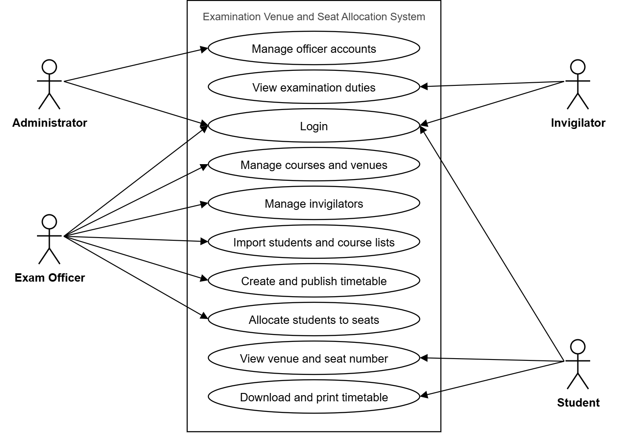
Use Case Diagram

Slide 9








Summary of Implementation Tools
Python 3.12
Back-end language
Django 6.0.3
Web framework
SQLite
Database
HTML, CSS, JavaScript
Pages and behaviour
openpyxl
Imports Excel files
Pillow
Makes PNG and JPG files
Visual Studio Code
Code editor
Git and GitHub
Version control

Slide 10




Summary of Testing Stages
Unit testing
126 automated tests, all passed
Integration testing
Full paths tested: import, register, allocate, check
System testing
15 test cases in the browser, all passed
Usability testing
25 students, average score 4.16 out of 5

Slide 11



Conclusions
Students are placed in venues and given random seat numbers.
An available invigilator is assigned to each venue.
Publishing is refused if a student has no seat, an exam has no venue, or two exams clash.
Students can check their venue and seat at any time.

Slide 12
References
1. Papaioannou, E., Vardakis, A., & Kaklamanis, C. (2018). oPESA: Online platform for automatic exam-hall seat allocation. International Journal of Engineering Technologies and Management Research, 5(6), 51–65. https://doi.org/10.29121/ijetmr.v5.i6.2018.245
2. Subhashini, S., Sreerambabu, J., & Riyaz, M. M. (2022). Online Examination Hall Seating Arrangement. International Journal for Research in Applied Science and Engineering Technology, 10(8), 962–964. https://doi.org/10.22214/ijraset.2022.46312
3. Adetona, S. O., & Akintoye, F. A. (2023). Design and implementation of an examination seating arrangement application to curb examination malpractice. ABUAD Journal of Engineering Research and Development, 6(2), 143–156. https://doi.org/10.53982/ajerd.2023.0602.14-j

Slide 13



Thank you
Questions?
Hauwa Kuliya Maliki · CST/22/SWE/00858

